Slide 1

Under the Esteemed Guidance of P NARENDRA BABU (Associate Prof of CSE Dept) Submitted by- 19KN1A05D6 19KN1A05F3 19KN1A05H8 20KN5A0514

Slide 2

Network Intrusion Detection system using Supervised Machine Learning techniques

Slide 3
ABSTRACT
A novel supervised machine learning system is developed to classify network traffic whether it is malicious or benign. To find the best model considering detection success rate, combination of supervised learning algorithm and feature selection method have been used. Through this study, it is found that Artificial Neural Network (ANN) based machine learning with wrapper feature selection outperform support vector machine (SVM) technique while classifying network traffic. To evaluate the performance, NSL-KDD dataset is used to classify network traffic using SVM and ANN supervised machine learning techniques. Comparative study shows that the proposed model is efficient than other existing models with respect to intrusion detection success rate.

Slide 4
EXISTING SYSTEM
The major challenges in evaluating performance of network IDS is the unavailability of a comprehensive network-based data set. Most of the proposed anomaly-based techniques found in the literature were evaluated using KDD CUP 99 dataset . In the existed system we used Decision Tree algorithm for network intrusion.

Slide 5
PROPOSED SYSTEM
The system proposed is composed of feature selection and learning algorithm like –SVM and ANN . Feature selection component are responsible to extract most relevant features or attributes to identify the instance to a particular group or class. The learning algorithm component builds the necessary intelligence or knowledge using the result found from the feature selection component. Using the training dataset NSL KDD, the model gets trained and builds its intelligence. Then the learned intelligences are applied to the testing dataset to measure the accuracy of the model correctly classified on unseen data.
NSL-KDD is a data set suggested to solve some of the inherent problems of the KDD'99 data set

Slide 6
Process Flow Diagram

Slide 7
TECHNIQUE USED OR ALGORITHM USED
IDS will be trained with all possible attacks signatures with machine learning algorithms and then generate train model, whenever new request signatures arrived then this model applied on new request to determine whether it contains normal or attack signatures.
we are evaluating performance of two machine learning algorithms such as Support Vector Machine and Artificial Neural Network. ANN outperform existing SVM in terms of accuracy.

Slide 8
evaluating performance of SVM and ANN.
In this algorithms we applied Correlation Based and Chi-Square Based feature selection algorithms to reduce dataset size, this feature selection algorithms removed irrelevant data from dataset and then used model with important features, due to this features selection algorithms dataset size will reduce and accuracy of prediction will increase.
Both SVM and ANN are Supervised Machine Learning Algorithm used for classification . It is to classify whether it is a normal or attack signatures.

Slide 9
HARDWARE REQUIREMENTS
PROCESSOR : PENTIUM IV 2.6 GHz
RAM : 512 MB
HARD DISK : 40 GB
SOFTWARE REQUIREMENTS
Front End : PYTHON
Operating System : Windows 7
IDE : Pycharm

Slide 10
UML DIAGRAMS
Class Diagram

Slide 11
Usecase Diagram

Slide 12
Activity Diagram
Represents the flow of the streamed data and it’s processing
Start
Load dataset
Data preprocessing
Data filtering
Calculate accuracy
Diaplay accuracy

Slide 13
Sequence Diagram
.

Slide 14
Collaboration Diagram

Slide 15
Sample code
#Training dataset using SVM
def runSVM():
text.delete('1.0', END)
global svm_acc
global classifier
global X, Y, X_train, X_test, y_train, y_test
total = X_train.shape[1];
X_train1 = SelectKBest(chi2,15).fit_transform(X_train, y_train)
X_test1 = SelectKBest(chi2,15).fit_transform(X_test,y_test)
text.insert(END,"Total Features : "+str(total)+"\n")
text.insert(END,"Features set reduce after applying features selection concept : "+str((total - X_train.shape[1]))+"\n\n")
cls = svm.SVC(kernel='rbf', class_weight='balanced', probability=True)
cls.fit(X_train, y_train)
text.insert(END,"Prediction Results\n\n")
prediction_data = prediction(X_test, cls)
svm_acc = cal_accuracy(y_test, prediction_data,'SVM Accuracy, Classification Report & Confusion Matrix')
classifier = cls

Slide 16
#Applying ANN algorithm
def runANN():
text.delete('1.0', END)
global ann_acc
global X, Y, X_train, X_test, y_train, y_test
total = X_train.shape[1];
X_train = SelectKBest(chi2,25).fit_transform(X_train, y_train)
X_test = SelectKBest(chi2,25).fit_transform(X_test,y_test)
text.insert(END,"Total Features : "+str(total)+"\n")
text.insert(END,"Features set reduce after applying features selection concept : "+str((total - X_train.shape[1]))+"\n\n")
model = Sequential()
model.add(Dense(30, input_dim=25, activation='relu'))
model.add(Dense(25, activation='relu'))
model.add(Dense(1, activation='sigmoid'))
model.compile(loss='binary_crossentropy', optimizer='adam', metrics=['accuracy'])
model.fit(X_train, y_train, epochs=100, batch_size=32)
_, ann_acc = model.evaluate(X_train, y_train)
ann_acc = ann_acc*100
text.insert(END,"ANN Accuracy : "+str(ann_acc)+"\n\n")

Slide 17
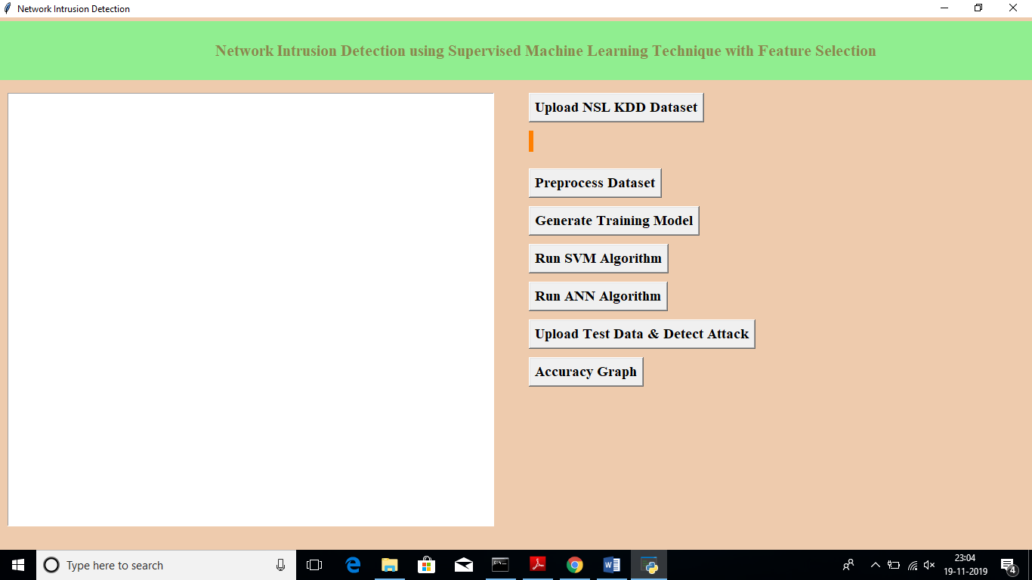
Output screenshots:

Slide 18
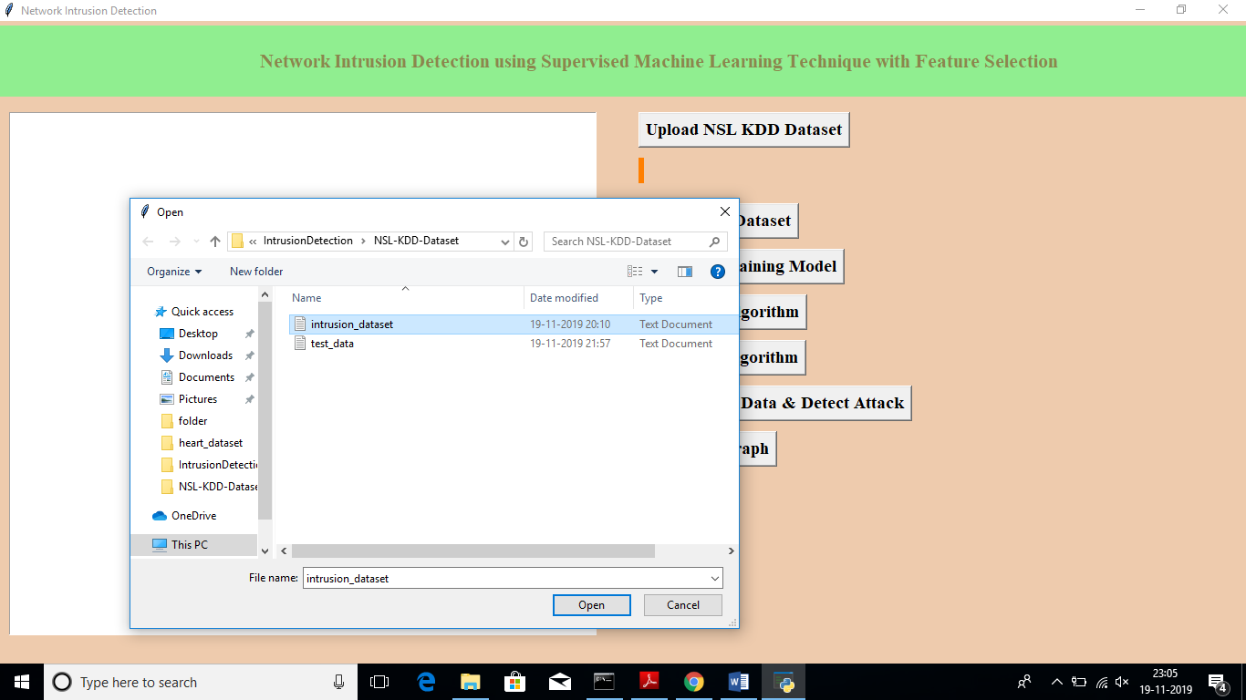
Uploading dataset

Slide 19
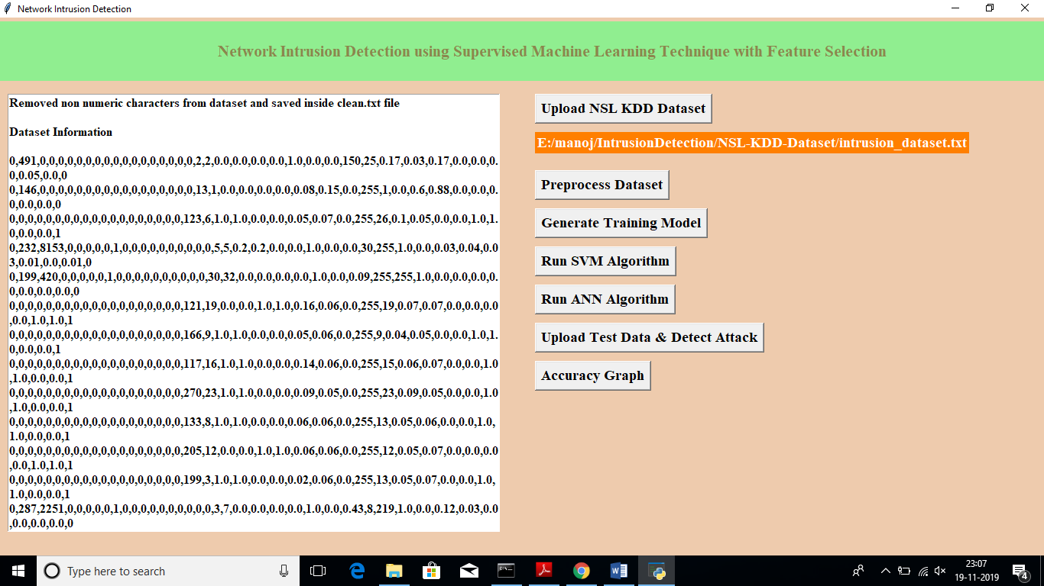
Dataset after pre-processing

Slide 20
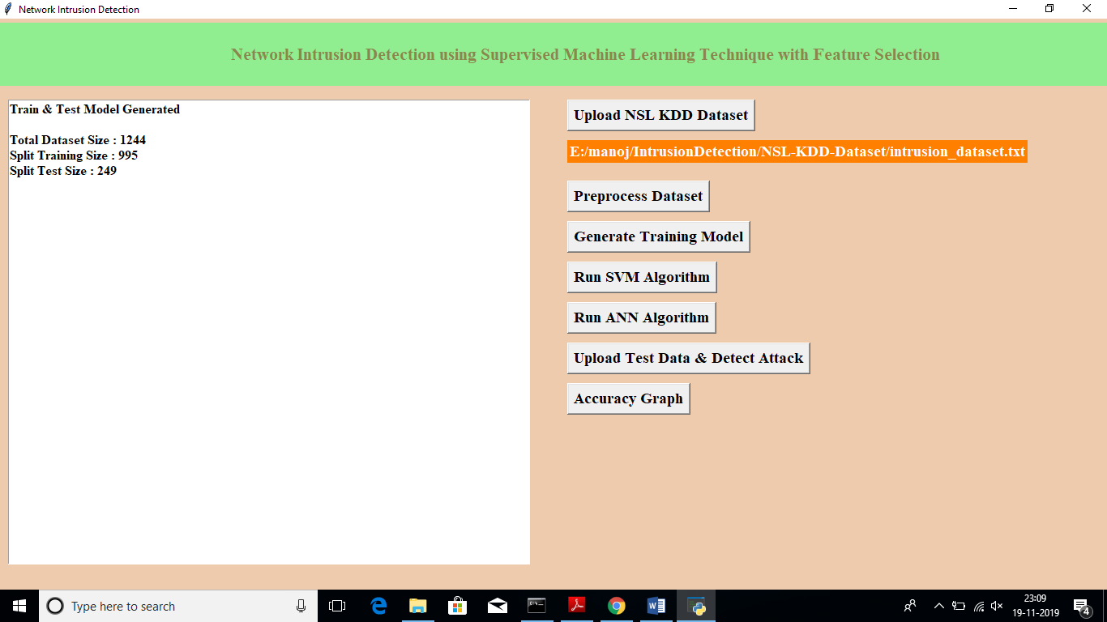
dataset contains total 1244 records and 995 used for training and 249 used for testing

Slide 21
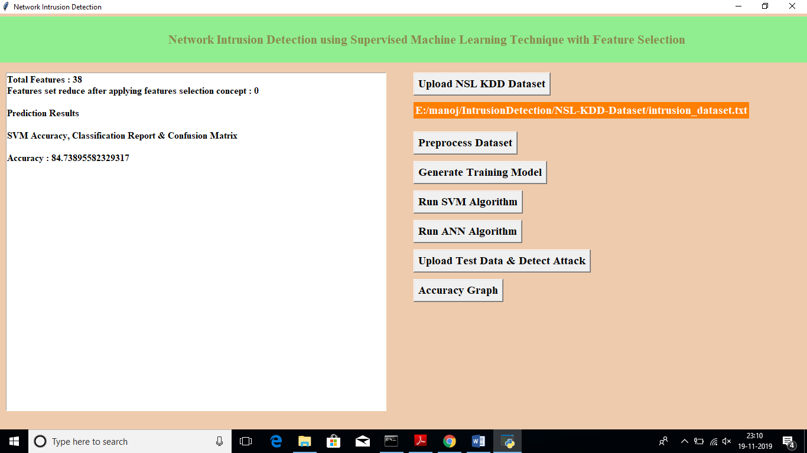
we can see with SVM we got 84.73% accuracy, now click on ‘Run ANN Algorithm’ to calculate ANN accuracy

Slide 22

we got 96.88% accuracy, now we will click on ‘Upload Test Data & Detect Attack’ button to upload test data and to predict whether test data is normal or contains attack.

Slide 23
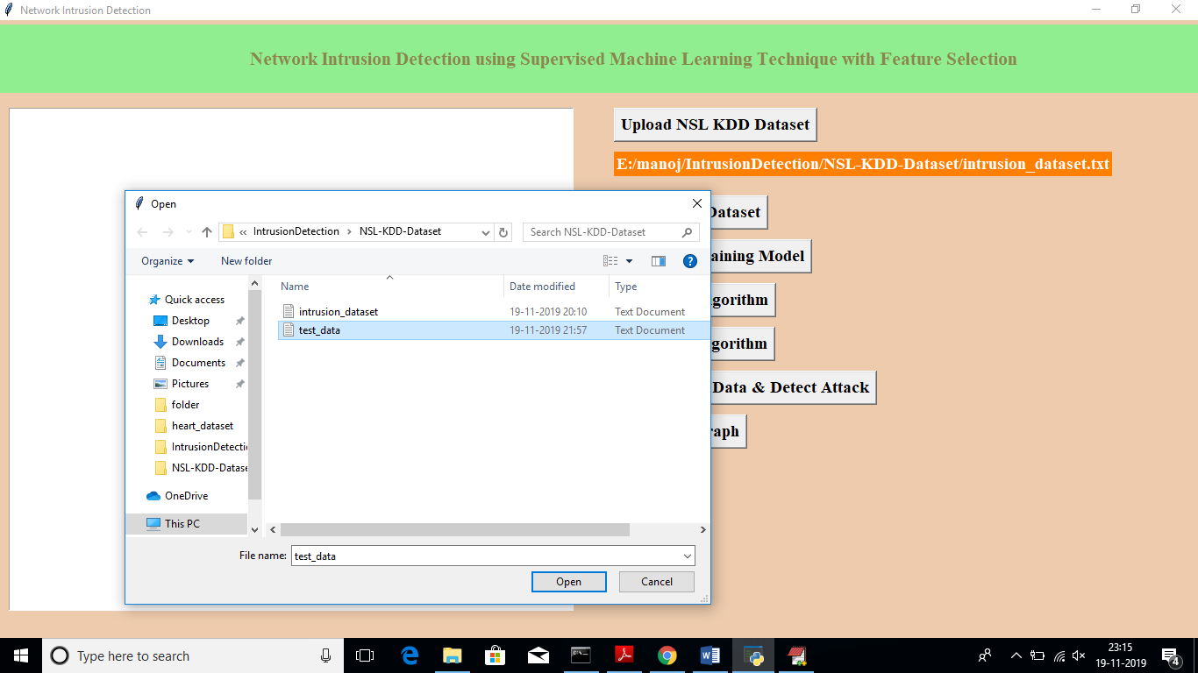
uploading ‘test_data’ file which contains test record

Slide 24
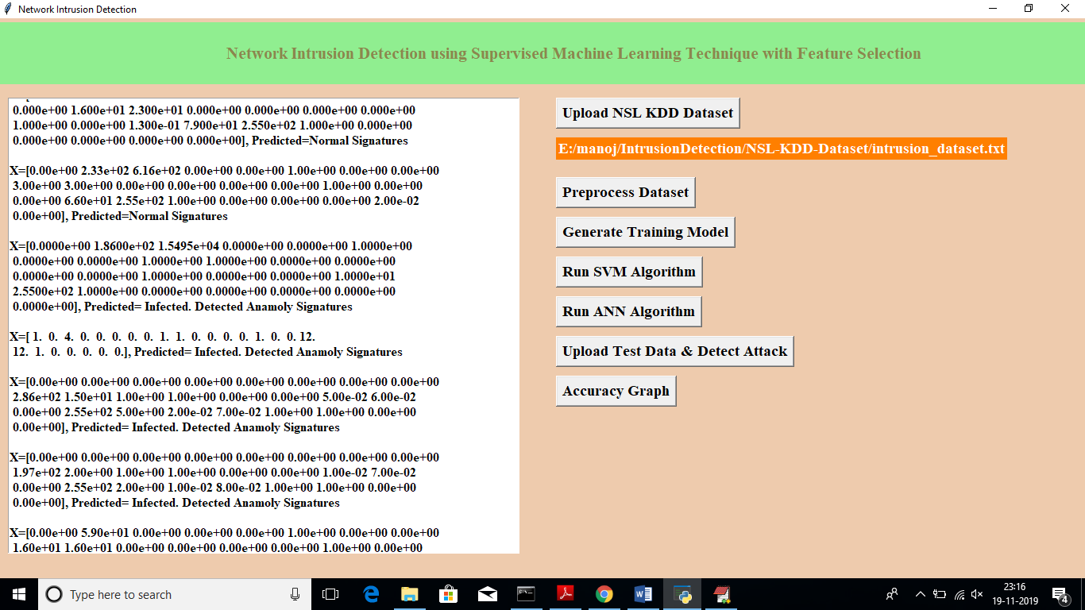
we got predicted results as ‘Normal Signatures’ or ‘infected’ record for each test record

Slide 25
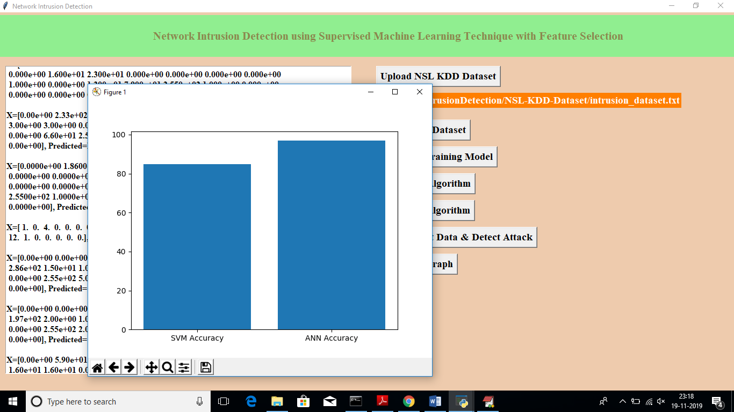
we can see ANN got better accuracy compare to SVM, in above graph x-axis contains algorithm name and y-axis represents accuracy of that algorithms

Slide 26
CONCLUSION
we conclude, different machine learning models using different machine learning algorithms and different feature selection methods to find a best model. The analysis of the result shows that the model built using ANN and feature selection outperformed all other models in classifying network traffic correctly with detection rate of 95% approximately.

Slide 27
FUTURE ENHANCEMENT
We believe that these findings will contribute to research further in the domain of building a detection system that can detect known attacks as well as novel attacks. The intrusion detection system exist today can only detect known attacks. Detecting new attacks or zero day attack still remains a research topic due to the high false positive rate of the existing systems.

Slide 28
references
P. Alaei and F. Noorbehbahani, “Incremental anomaly-based intrusion detection system using limited labeled data,” in Web Research (ICWR), 2017 3th International Conference on, 2017, pp. 178–184.
M. Saber, S. Chadli, M. Emharraf, and I. El Farissi, “Modeling and implementation approach to evaluate the intrusion detection system,” in International Conference on Networked Systems, 2015, pp. 513–517.
M. Tavallaee, N. Stakhanova, and A. A. Ghorbani, “Toward credible evaluation of anomaly-based intrusion-detection methods,” IEEE Transactions on Systems, Man, and Cybernetics, Part C (Applications and Reviews), vol. 40, no. 5, pp. 516–524, 2010.
A. S. Ashoor and S. Gore, “Importance of intrusion detection system (IDS),” International Journal of Scientific and Engineering Research, vol. 2, no. 1, pp. 1–4, 2011.
M. Zamani and M. Movahedi, “Machine learning techniques for intrusion detection,” arXiv preprint arXiv:1312.2177, 2013.
N. Chakraborty, “Intrusion detection system and intrusion prevention system: A comparative study,” International Journal of Computing and Business Research (IJCBR) ISSN (Online), pp. 2229–6166, 2013.

Slide 29


